Slide 1
Uncertain Knowledge Certainty Factors Fuzzy Logic Basics
By
Adnan Majeed

Slide 2
1. Uncertain Knowledge in Knowledge-Based Systems
1.1 Introduction to Uncertainty
In real-world problems, knowledge is often:
Incomplete
Imprecise
Ambiguous
Noisy
Contradictory
Knowledge-Based Systems (KBS), especially Expert Systems, must handle uncertainty effectively.

Slide 3
Sources of Uncertainty
Incomplete Information – Missing data (e.g., medical tests not done)
Measurement Errors – Sensor inaccuracies
Ambiguity – Vague concepts like “high temperature”
Conflicting Evidence – Different experts give different rules
Randomness – Inherent variability in systems

Slide 4
1.2 Types of Uncertainty
1. Aleatory Uncertainty (Randomness)
Caused by inherent variability
Example: Weather changes
2. Epistemic Uncertainty (Lack of Knowledge)
Caused by incomplete information
Example: Unknown patient history

Slide 5
1.3 Representing Uncertain Knowledge
Common approaches:
Probability Theory
Certainty Factors
Fuzzy Logic
Bayesian Networks
Dempster-Shafer Theory

Slide 6
1.4 Why Classical Logic is Not Enough?
Classical (Boolean) logic:
Statements are either True (1) or False (0)
Cannot handle partial truths
Example:
“Patient has high fever.”
What if temperature is 99.5°F?
Not completely high, not completely normal.
Hence, uncertainty models are required.

Slide 7
2. Certainty Factors (CF)
2.1 Introduction
Certainty Factors were introduced in the medical expert system MYCIN.
They represent degree of belief in a hypothesis.

Slide 8
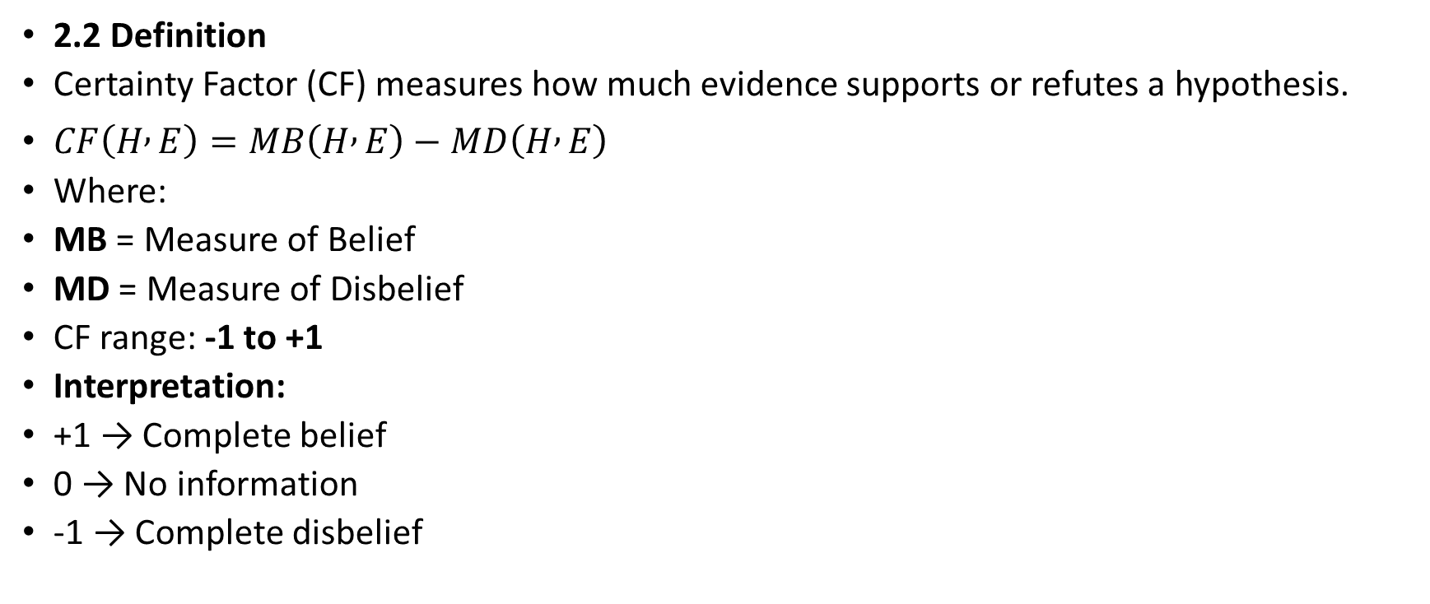
2.2 Definition
Certainty Factor (CF) measures how much evidence supports or refutes a hypothesis.
$CF\left(H , E\right)=MB\left(H , E\right)−MD\left(H , E\right)$
Where:
MB = Measure of Belief
MD = Measure of Disbelief
CF range: -1 to +1
Interpretation:
+1 → Complete belief
0 → No information
-1 → Complete disbelief

Slide 9
2.3 Rule Format with Certainty Factor
IF Symptom A THEN Disease B CF = 0.8
Meaning: 80% confidence in conclusion.

Slide 10
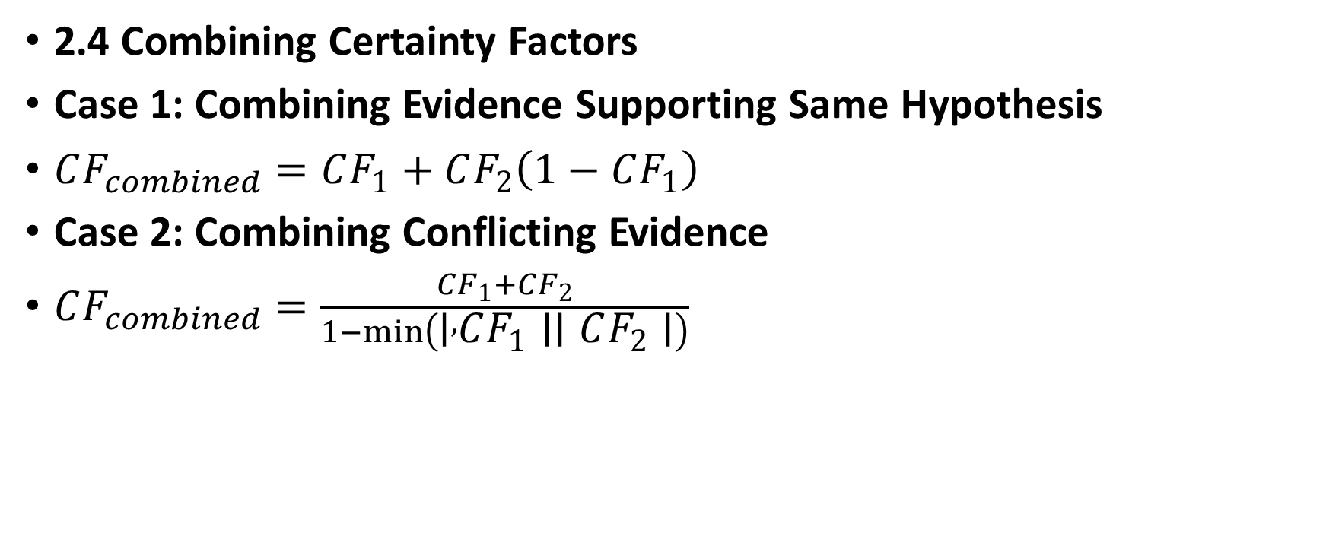
2.4 Combining Certainty Factors
Case 1: Combining Evidence Supporting Same Hypothesis
$CF_{combined}=CF_{1}+CF_{2}\left(1−CF_{1}\right)$
Case 2: Combining Conflicting Evidence
$CF_{combined}=\frac{CF_{1}+CF_{2}}{1−min⁡\left(∣ , CF_{1}∣∣CF_{2}∣\right)}$

Slide 11
2.5 Advantages of Certainty Factors
Simple to implement
Intuitive
Suitable for rule-based systems
Computationally efficient

Slide 12
2.6 Limitations
Not mathematically rigorous like probability
Subjective assignment of CF values
Not ideal for complex dependencies

Slide 13
3. Fuzzy Logic Basics
3.1 Introduction
Fuzzy Logic was introduced by Lotfi A. Zadeh in 1965.
Unlike classical logic:
Truth values range between 0 and 1
Handles vagueness instead of randomness

Slide 14
3.2 Classical vs Fuzzy LogicClassical Logic Fuzzy LogicTrue or False Partial truth (0 to 1)Crisp sets Fuzzy setsSharp boundaries Gradual boundaries

Slide 15
3.3 Fuzzy Sets
In classical sets:
x ∈ A → 1
x ∉ A → 0
In fuzzy sets:
Each element has membership degree (µ) between 0 and 1.
Example: Temperature = 30°C
Membership in “Hot” = 0.7
Membership in “Warm” = 0.5

Slide 16
3.4 Membership Function
A membership function defines how each input maps to membership value.
Common shapes:
Triangular
Trapezoidal
Gaussian
Sigmoid

Slide 17
3.5 Fuzzy Rule-Based System
Structure:
Fuzzification
Rule Base
Inference Engine
Defuzzification

Slide 18
3.5.1 Fuzzification
Converts crisp input into fuzzy values.
Example: Temperature = 35°C → Hot = 0.8

Slide 19
3.5.2 Fuzzy Rule
IF Temperature is Hot THEN Fan Speed is High
Rules are written in linguistic form.

Slide 20
3.5.3 Inference Mechanism
Common methods:
Mamdani Inference
Sugeno Inference

Slide 21
3.5.4 Defuzzification
Converts fuzzy output into crisp value.
Common methods:
Centroid Method (most popular)
Mean of Maximum
Weighted Average

Slide 22
3.6 Applications of Fuzzy Logic
Washing machines
Air conditioners
Camera autofocus
Traffic control systems
Medical diagnosis

Slide 23
3.7 Advantages of Fuzzy Logic
Handles vagueness effectively
Easy to model expert knowledge
No need for precise mathematical model
Human-like reasoning

Slide 24
3.8 Limitations
Rule explosion in large systems
Subjective membership functions
Not suitable for purely probabilistic problems

Slide 25
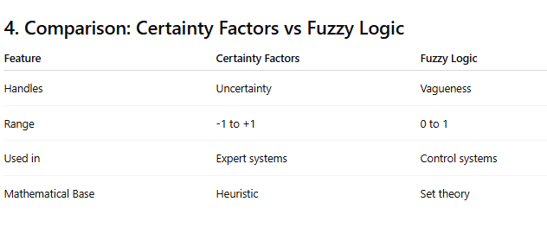

Slide 26
5. Summary
Real-world knowledge is uncertain and imprecise.
Classical logic cannot handle partial truths.
Certainty Factors model degree of belief.
Fuzzy Logic models vagueness using membership functions.
Both techniques are essential in Knowledge-Based Systems.

